Slide 1

Requirements Gathering
A How To Guide for small web projects

Slide 2
What is a Requirement
Typically Broken into two categories there are two types of requirements,
Primary and Derived.
Primary requirements are typically anything that could be assigned as a baseline to a contractor to be completed within a timeframe.
Derived requirements as the name implies a part of a primary requirements. They are typically used to help a team Identify and break down subcomponents into manageable pieces

Slide 3
Example Of Primary and Derived
Many clients will ask for features in vague ways, you will need to provide more elaboration to create a full picture of what they want.
In a Web project a client may ask for a resizable website(Responsive) without going into much elaboration. A Primary Requirement
Then as Developers our derived requirement from this might be the specific sizes that the website would need to resize for example the sizes 1920X1080(desktop), 360X640(Mobile), 768X1024(Google’s Nexus Tablet) A Derived Requirement

Slide 4
Gathering Primary Requirements
Typically, during a first conversation with a client we can attain a large portion of the Primary requirements of a web project.
Taking notes during a meeting is essential and group members should combine notes after a meeting.
What might a client want as media for a web project? Logo, Layout, additional graphic design etc.
What kind of content should be written?
How many pages are there in the project?
All these are Necessary questions that can typically be answered as the client pitches their business.

Slide 5
Analyzing Primary Requirements
Each Primary Requirement for time management and task assignment purpose can logically broken apart into derived requirements.
Typically, if a task takes more than a week to accomplish it must be broken down further.
Primary Requirements can be represented in a use case diagram for smaller systems and websites.
A use case diagram can be accompanied with a requirement readout

Slide 6
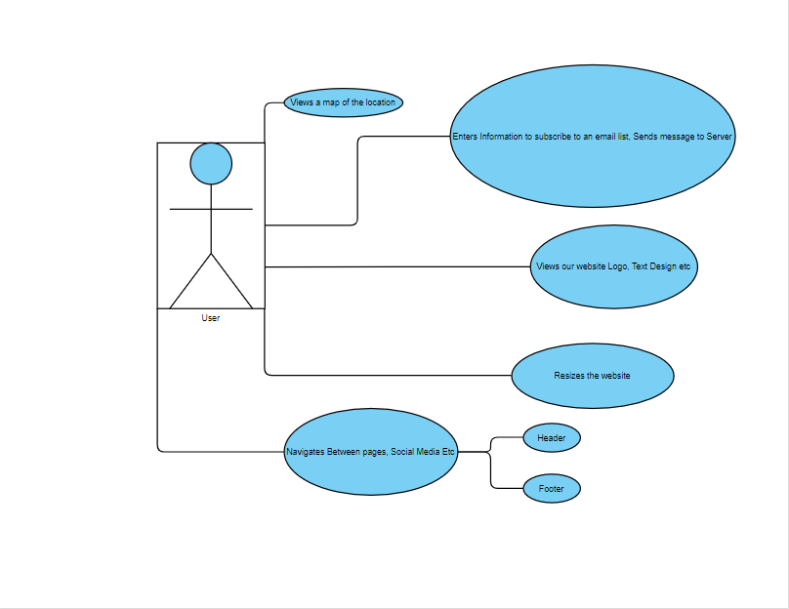
Example Use Case
This use case represents a simplified web site with general requirements.
Typically, after an interaction with a client these things become more clear and can be finalized.

Slide 7
Requirement Read Out
A requirement readout is represented differently depending on a variety of factors those being Complexity, Scale, Derived requirements, time management, Database models, Cost.
Larger projects typically require something called an SRS.
Smaller projects can be covered in a well-defined checklist and an effective diagram representing a user’s interactions.
Those requirements will typically be revised and altered several times before implementation occurs and sets the foundation for any design being made.

Slide 8
Clarifying questions
Typically, after a first meeting there is time in between the core pitch when the direct details and requirements have been finalized.
This is a great opportunity to explore and expand on the customers vision with questions.
Sometimes these questions involving clarify concerns other times it might involve asking questions about things that might not have been covered related to the project.
These questions are typically kept as notes until its time or are Emailed to the client as requirements are finalized.

Slide 9
Summary
Listen and takes notes during a client's pitch
Have general questions ready for a client ahead of time
Dress to impress in a video environment.
Understanding their business’s purpose helps move along the design process
Derived requirements can be gathered after a first meeting with a client and questions can be asked to clarify any assumptions, we might make
Generating a requirement readout can help improve the understanding of project timeline and give groups a high level checklist for project completion.

Slide 10
Bibliography
SOFTWARE REQUIREMENTS ENGINEERING, Second Edition
Constantine Grigoriadis, Thoughts and abstractions.

